Slide 1

CARES Implementation Phase
Rollout #4 PTAX Bi-Weekly Touch Point
July 30, 2025

Slide 2
Agenda
AGO Collections modernization initiative
UAT Changes/Defects Update
Schedule Review
UAT Results Update
Cutover Update
Action Items Update
Comments/Questions

Slide 3
TAX-AGO Interfaces
CUBS | DM | Name
9020 | XCI | Cert Import
9011 | XFI | Transaction Import
9407.40 | XDI | Decert Import
9011.40 | XNI | NonFinancial Import
9008 | XAI | Address Update Import
8050.98 | XADO | Active Data Outbound
8050 | XFO | Transaction Outbound
8050.40 | XNFO | Non-Financial Outbound

Slide 4
User Acceptance Testing – Changes
ID | Test Case | Name | Update
60017 |  | Payment Error File – ETL rejects entire file | Reversing file-level reject decision and making Type-Application failures be record-level rejects
62017 | EXXCI_0056 | Abatement Letter Deny sent off historical data in XCI | When abatement approvals/denials come in on the XNI, a letter is triggered to be sent. Using this same field with historical information provided in the XCI was also triggering this letter. Change being made to exclude Y/N informational fields in XCI from triggering letter.
62052 | EXFP_0043; EXXFI_0001, 0012, 0013, 0014, 0019 | Changes to TrueUp – Payment not applied in DM due to overpayment | TrueUp call was getting live account balance, but DM account doesn’t reflect this current balance until interest accrues or payment posts. TrueUp adding an additional call to add a tag on accounts expecting payments so that DM can post the accrued interest/fees and prevent this balance discrepancy
62053 | EXFP_0020 EXFP_0019 | Payment CSV needs DM Transaction ID | Adding unique DM payment identifier to invoice payment details
62086 | EXXCI_0025 | XCI File Load Failure – Lien Demo UDP & Foreign State Code | A MEX state ID was causing an error because the lien address information field is limited to 2 characters. Since out-of-state liens are filed in Franklin county, we are changing the non-US state fields to map to OH for lien addresses (MEX to remain on debtor address)
62088/63058 | EXXFO_0001 | Assessment Errored out and did not process in ODT system (Negative Payments); Removal of Overpayments and Autorefunds reporting from XFO | Initially, the error was caused by a debtor refund being reported in the XFO. We have submitted a change to exclude this transaction type from being in our outbound file & we have excluded amounts posting to the OVP bucket. In the case that negative payments should still need to be used as a workaround, ODT can accept those and error out to a Work Item.
62117 |  | Number of records sent in XADO does not match accounts in ODT active system | It appeared AGO had balances on about 1 million accounts that ODT had no remaining balance for. We are changing this interface to report account current balance, instead of account original balance.
Passed!
Passed!
Retesting
Passed!
Passed!
Passed!
Retesting

Slide 5
User Acceptance Testing – Defects
AGO ID | Test Case ID | Name | Notes
60051 |  | Tags Notification to Taxation – XADO or XNFO | Tags cheat sheet needed; ticket stemming from clarification questions about tags seen in these files
61052 | EXFP_0060 | Interest Hold Tag | Identified an issue with migrated interest hold tags and the release of those holds
62056 | EXXFI_0022 | Payment reversal through XFI | Retesting
62087 | EXXNI_0018 | Secondary DOD through XNI | Retesting
62110 |  | XFI – need to match on multiple transactions for migrated payment reversals | Development completed; Target delivery date from C&R to AGO: 7/30/2025. Anticipated retest dates: 7/30-7/31/2025.
62119 | EXXCI_0039 | School District ID in Additional Information UDP | Retesting
63016 |  | Issues with XCI Trailer-Only file processing | Submitted as ticket 6/27
Closed
Passed!
Passed!
Passed!
Passed!
Passed!

Slide 6
Schedule Review
We are here

Slide 7
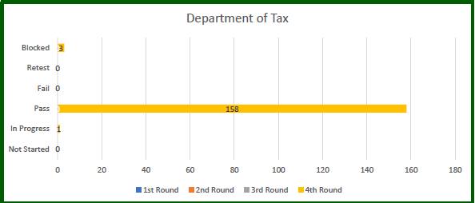
UAT Results - Updates
Data reported through 7/29/2025

Slide 8
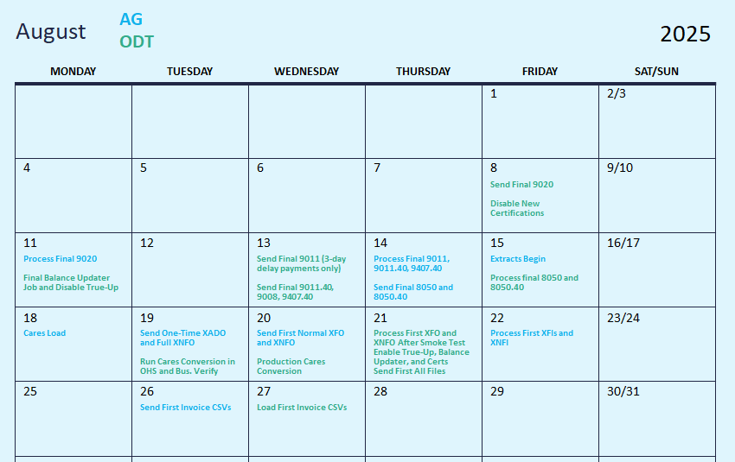
ODT/AGO Proposed* Cutover Calendar
ODT proposed business validation time frame: 8/19/2025 from 3-5pm
*as of 7/28/2025

Slide 9
Cutover Updates
Taxation involvement may be requested in continued cutover discussions this week
Cutover walk-throughs are planned to begin next week.
  Requesting Taxation’s involvement for those activities, as well.
  First set of walk-through dates are set for Tuesday, 8/5/2025 and Wednesday, 8/6/2025 from 3-4pm.
  Second walk-through is scheduled for 8/8/2025 from 10am-12pm

Slide 10

Action Items
Action Item | Responsible Party | Status
ITSEC01 Form for Service Account | Taxation (Kelly) | Completed
Production URL to Taxation | AGO ITS | Completed
ITSEC03 Forms for E2E and UAT/Production | Taxation (Kelly) | Completed
True Up Web Service development | Taxation (Chris B.) | Completed
True Up Web Service testing | Taxation/AGO QA | Completed
File programming changes for R4 development items | Taxation | Completed
End-to-End System testing – Inbound Files | Taxation | Completed
End-to-End System testing – Outbound Files | C&R/AGO QA | Completed
Finalize User Acceptance Testing scenarios | Taxation/AGO UAT | Completed
Establish Communication Process for External UAT Status and Defect Reporting | AGO UAT/AGO ITS | Completed
Notes:
Per Kelly and Chris B., the programming adjustments necessary for go-live have been completed on the Taxation side.

Slide 11
Comments/Questions?

Slide 12
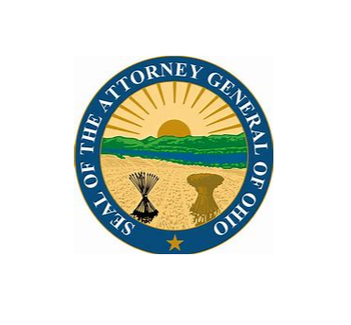
Thank You!

