Slide 1

CARES Implementation Phase
Rollout #4 PTAX Bi-Weekly Touch Point
July 2, 2025

Slide 2
Agenda
AGO Collections modernization initiative
UAT Failures – Updates
Schedule Review
User Acceptance Testing Targets
UAT Results – Updates
Cutover Touch Point
Action Items Update
Comments/Questions

Slide 3
TAX-AGO Interfaces
CUBS | DM | Name
9020 | XCI | Cert Import
9011 | XFI | Transaction Import
9407.40 | XDI | Decert Import
9011.40 | XNI | NonFinancial Import
9008 | XAI | Address Update Import
8050.98 | XADO | Active Data Outbound
8050 | XFO | Transaction Outbound
8050.40 | XNFO | Non-Financial Outbound

Slide 4
User Acceptance Testing – Changes
ID | Test Case | Name | Description of Change
60017 |  | Payment Error File – ETL rejects entire file | Reversing file-level reject decision and making Type-Application failures be record-level rejects
62017 | EXXCI_0056 | Abatement Letter Deny sent off historical data in XCI | When abatement approvals/denials come in on the XNI, a letter is triggered to be sent. Using this same field with historical information provided in the XCI was also triggering this letter. Change being made to exclude Y/N informational fields in XCI from triggering letter.
62052 | EXFP_0043 | Changes to TrueUp – Payment not applied in DM due to overpayment | TrueUp call was getting live account balance, but DM account doesn’t reflect this current balance until interest accrues or payment posts. TrueUp adding an additional call to add a tag on accounts expecting payments so that DM can post the accrued interest/fees and prevent this balance discrepancy
62053 | EXFP_0020 | TX Payment CSV needs DM Transaction ID | Adding unique DM payment identifier to invoice payment details
62054 | EXFP_0019 | AG Payment CSV needs DM Transaction ID | Adding unique DM payment identifier to invoice payment details
62086 | EXXCI_0025 | XCI File Load Failure – Lien Demo UDP & Foreign State Code | A MEX state ID was causing an error because the lien address information field is limited to 2 characters. Since out-of-state liens are filed in Franklin county, we are changing the non-US state fields to map to OH for lien addresses (MEX to remain on debtor address)
62088 | EXXFO_0001 | Assessment Errored out and did not process in ODT system (Negative Payments) | Initially, the error was caused by a debtor refund being reported in the XFO. We have submitted a change to exclude this transaction type from being in our outbound file & we have excluded amounts posting to the OVP bucket. In the case that negative payments should still need to be used as a workaround, ODT can accept those and error out to a Work Item.
62117 |  | Number of records sent in XADO does not match accounts in ODT active system | It appeared AGO had balances on about 1 million accounts that ODT had no remaining balance for. We are changing this interface to report account current balance, instead of account original balance.
Notes:
Please note: Changes require CARES leadership approval, design updates, development, and testing with the developer before they are released to the AGO for QA/UAT. This process does take a bit of time, so these may not be ready to test from the UAT perspective by July 18th. Some retesting/validations may be necessary after that date.

Slide 5
User Acceptance Testing – Defects
AGO ID | Test Case ID | Name | Notes
60051 |  | Tags Notification to Taxation – XADO or XNFO | Tags cheat sheet needed; ticket stemming from clarification questions about tags seen in these files
61052 | EXFP_0060 | Interest Hold Tag | Identified an issue with migrated interest hold tags and the release of those holds
62056 | EXXFI_0022 | Payment reversal through XFI | Retesting
62087 | EXXNI_0018 | Secondary DOD through XNI | Retesting
62110 |  | XFI – need to match on multiple transactions for migrated payment reversals | Submitted as ticket, discussion with C&R needed
62119 | EXXCI_0039 | School District ID in Additional Information UDP | Retesting
63016 |  | Issues with XCI Trailer-Only file processing | Submitted as ticket 6/27

Slide 6
Schedule Review
We are here

Slide 7
User Acceptance Testing Targets
Phase 1: 5/19/2025 – 7/18/2025 | Phase 2: 7/19/2025 – 8/1/2025
Inbound Interfaces | Target Dates for Test Completions | Start date | End Date | Number of accounts requested
XAI - Address Update 9008 | Daily starting 5/21 | 5/19/2025 | 7/18/2025 | TBD (driven by test cases completed daily)
XFI - Transaction Import 9011 | Daily, at least 5/26-6/6 | 5/19/2025 | 7/18/2025
XNI - NonFinancial 9011.40 | Daily starting 5/21 | 5/19/2025 | 7/18/2025
XCI - Cert 9020 | 5/20-5/27 | 5/19/2025 | 7/18/2025
XDI - Decert 9407.40 | Daily starting 5/21 | 5/19/2025 | 7/18/2025
Outbound Interfaces
XFO - Transaction Export (IB.8050) | Daily 5/26-6/6 | 5/19/2025 | 7/18/2025
XNFO - NonFin Export (IB.8050.40) | Daily starting 5/21 | 5/19/2025 | 7/18/2025
XADO - Tax Archive DATAEXTRACT 8050.98 | 5/19/2025 | 5/19/2025 | 7/18/2025
True Up Web Service (API Call) | Daily starting 5/21 | 5/19/2025 | 7/18/2025
FitPortal Account Validations | 5/21-6/13 | 5/19/2025 | 7/18/2025
FitPortal Report Validations | 5/21-6/13 | 5/19/2025 | 7/18/2025
Invoicing Validations | 6/9-7/3* | 5/19/2025 | 7/18/2025
Notes:
*Date adjusted due to ongoing invoice regression testing completed by Accounting, limiting ability to generate an invoice for a full week’s worth of transactions.

Slide 8
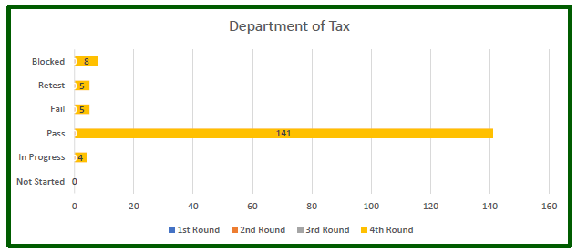
UAT Results - Updates
Data reported through 6/30/2025

Slide 9
Cutover Touch Point
Pre-Cutover Meeting set for 7/2/2025 @ 1pm
Objectives:
  Exploratory discussion to determine necessary activities from the Taxation perspective for CARES Rollout 4 go-live
  Anticipated timings of these activities
  Cutover considerations from the Taxation perspective

Slide 10


Action Items
Action Item | Responsible Party | Status
ITSEC01 Form for Service Account | Taxation (Kelly) | Completed
Production URL to Taxation | AGO ITS | Completed
ITSEC03 Forms for E2E and UAT/Production | Taxation (Kelly) | Completed
True Up Web Service development | Taxation (Chris B.) | Completed
True Up Web Service testing | Taxation/AGO QA | Completed
File programming changes for R4 development items | Taxation | In progress
End-to-End System testing – Inbound Files | Taxation | Completed
End-to-End System testing – Outbound Files | C&R/AGO QA | In progress
Finalize User Acceptance Testing scenarios | Taxation/AGO UAT | Completed
Establish Communication Process for External UAT Status and Defect Reporting | AGO UAT/AGO ITS | Completed
Notes:
Per Kelly, the programming adjustments necessary for UAT have been completed on their side. There are a few outstanding adjustments needed for their Production environment still.

Slide 11
Comments/Questions

Slide 12
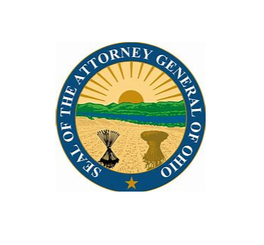
Thank You!

