Slide 1

CARES Implementation Phase
Rollout #4 PTAX Bi-Weekly Touch Point
June 4, 2025

Slide 2
Agenda
AGO Collections modernization initiative
Schedule Review
User Acceptance Testing Targets
UAT Results – Updates
UAT Failures - Updates
Action Items Update
Comments/Questions

Slide 3
Schedule Review
We are here

Slide 4
User Acceptance Testing Targets
Phase 1: 5/19/2025 – 7/18/2025 | Phase 2: 7/19/2025 – 8/1/2025
Inbound Interfaces | Target Dates for Test Completions | Start date | End Date | Number of accounts requested
XAI - Address Update 9008 | Daily starting 5/21 | 5/19/2025 | 7/18/2025 | TBD (driven by test cases completed daily)
XFI - Transaction Import 9011 | Daily, at least 5/26-6/6 | 5/19/2025 | 7/18/2025
XNI - NonFinancial 9011.40 | Daily starting 5/21 | 5/19/2025 | 7/18/2025
XCI - Cert 9020 | 5/20-5/27 | 5/19/2025 | 7/18/2025
XDI - Decert 9407.40 | Daily starting 5/21 | 5/19/2025 | 7/18/2025
Outbound Interfaces
XFO - Transaction Export (IB.8050) | Daily 5/26-6/6 | 5/19/2025 | 7/18/2025
XNFO - NonFin Export (IB.8050.40) | Daily starting 5/21 | 5/19/2025 | 7/18/2025
XADO - Tax Archive DATAEXTRACT 8050.98 | 5/19/2025 | 5/19/2025 | 7/18/2025
True Up Web Service (API Call) | Daily starting 5/21 | 5/19/2025 | 7/18/2025
FitPortal Account Validations | 5/21-6/13 | 5/19/2025 | 7/18/2025
FitPortal Report Validations | 5/21-6/13 | 5/19/2025 | 7/18/2025
Invoicing Validations | 6/9-6/17* | 5/19/2025 | 7/18/2025
Notes:
*Date adjusted due to ongoing invoice regression testing completed by Accounting, limiting ability to generate an invoice for a full week’s worth of transactions.

Slide 5
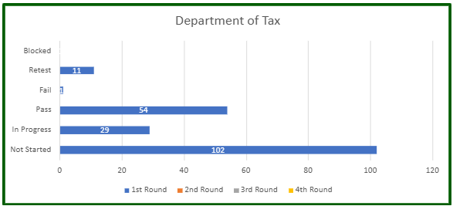
UAT Results - Updates
Data reported through 6/3/2025

Slide 6
UAT Failures – Updates
Notes:
Closed items are in need of retest for the most part; were determined to be working as designed and should be retested with the feedback provided taken into consideration.
Per Kelly, some items that are awaiting retest are waiting for certain files to be run/validated before being updated.

Slide 7


Action Items
Action Item | Responsible Party | Status
ITSEC01 Form for Service Account | Taxation (Kelly) | Completed
Production URL to Taxation | AGO ITS | Completed
ITSEC03 Forms for E2E and UAT/Production | Taxation (Kelly) | Completed
True Up Web Service development | Taxation (Chris B.) | Completed
True Up Web Service testing | Taxation/AGO QA | Completed
File programming changes for R4 development items | Taxation | In progress
End-to-End System testing – Inbound Files | Taxation | Completed
End-to-End System testing – Outbound Files | C&R/AGO QA | In progress
Finalize User Acceptance Testing scenarios | Taxation/AGO UAT | Completed
Establish Communication Process for External UAT Status and Defect Reporting | AGO UAT/AGO ITS | Completed
Notes:
Per Kelly, the programming adjustments necessary for UAT have been completed on their side. There are a few outstanding adjustments needed for their Production environment still.

Slide 8
Comments/Questions

Slide 9
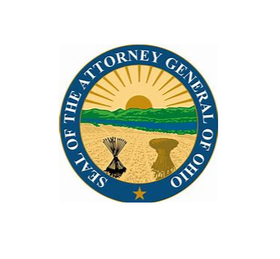
Thank You!

