Slide 1
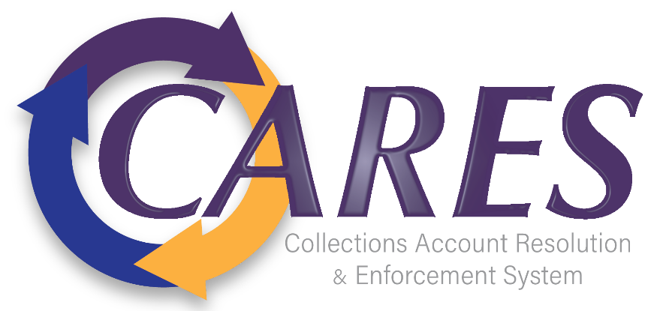
CARES Implementation Phase
Rollout #4 PTAX Bi-Weekly
August 28, 2024

Slide 2
Agenda
AGO Collections modernization initiative
Schedule Review
Workflows Progress
Upcoming Engagement
Pain Points/Concerns Discussion
Resources Check-in / Design Session Feedback
Comments/Questions

Slide 3
Schedule Review
We are here

Slide 4
Non-Technical Workflows
Design Session | AGO Owner | Dates Held | Comments
WF-19 Innocent Spouse | Kevin Whitacre, Nicole Brock | 8/5/2024-8/13/2024 | Formal approval stage
WF-48 Tax Collections | Sharnee Jennings, Nick Yono | 7/29/2024-8/23/2024 | Final walk-through completed
Skip Trace | Shannon Ray, Lucas Ward | 6/26/2024-8/12/2024 | Final walk-through completed
Workflow Look-backs | Sharnee Jennings, Nick Yono | 8/26/2024-present | Ongoing through iteration 2

Slide 5
Technical Workflows
Design Session | AGO Owner | Dates Held | Comments
SOVOS-1099 | David Boals, James Seeto | 8/1/2024-8/20/2024 | Formal approval stage
Skip Tracing Interface | Shannon Ray, Lucas Ward | 6/26/2024-8/21/2024 | Final walk-through completed
BKY Skip Tracing | Shannon Ray, Lucas Ward, Trish Lazich | 8/5/2024-8/12/2024 | Final walk-through completed
Migration Discussions | Billy Miller, Timothy Greene | 7/29/2024-Present | Ongoing Migration discussions; first look at mapping in progress
Certification (9020) Interface | Sharnee Jennings, Nick Yono | 8/26/2024-present | Design sessions in progress

Slide 6
Upcoming Engagement
Session Name | Date(s)
Certification (9020) Interface | 8/29/2024: 1-3pm
Address Update (9008) Interface | 8/30/2024: 10am-12pm*
Non-Financial (9011.40) Interface | 9/3/2024: 1-3pm* 9/5/2024: 10am-12pm*
Decert (9407.40) Interface | 9/6/2024: 10am-12pm*
Transaction Import (9011) | 9/12/2024: 1-3pm* 9/13/2024: 10am-12pm*
True Up Web Service (8405.40) | 9/16/2024: 1-3pm* 9/17/2024: 1-3pm* 9/19/2024: 10am-12pm* 9/19/2024: 1-3pm* 9/20/2024: 10am-12pm*
*Subject to change

Slide 7
Validation of Stakeholder Feedback
Pain Points/Concerns - Updated
Current collections system is inefficient and not programmed to handle certain aspects of the collections process, necessitating manual intervention (i.e., Tax memos process, payment error reports, )
Concerns around Client Invoicing as it relates to the current Compass Reports system
Concerned about system access for Debt Manager (as some Tax Examiners can currently access debtors in CUBS directly), and ensuring that their agents should only be able to view and add notes
Concerns re: eliminating debt by bucket
Concerns about AGI/CC calculating and being removed appropriately, both manually and when Tax passes an adjustment to the AGO for updates
AGO processing overpayments without Tax memo/prompting
Out of statute overpayments following Tax Statute and allowing adjustments to pass to DM accordingly
Ease of taxpayer registration for the payment portal (out of scope)
TOPS notices – can the AGO send?

Slide 8
Resource Check-in /
Design Session Feedback

Slide 9
Comments/Questions

Slide 10
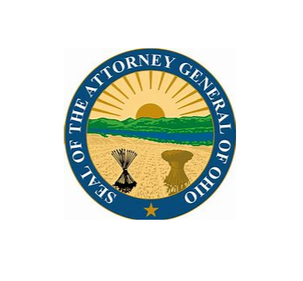
Thank You!

