Slide 1

CARES Implementation Phase
Rollout #4 PTAX Bi-Weekly
September 11, 2024

Slide 2
Agenda
AGO Collections modernization initiative
Schedule Review
Workflows Progress
Design and Testing Timeline
Upcoming Engagement
Pain Points/Concerns Discussion
Resources Check-in / Design Session Feedback
Comments/Questions

Slide 3
Schedule Review
We are here

Slide 4
Non-Technical Workflows
Design Session | AGO Owner | Dates Held | Comments
WF-19 Innocent Spouse | Kevin Whitacre, Nicole Brock | 8/5/2024-8/13/2024 | Demonstration of process in DM completed
WF-48 Tax Collections | Sharnee Jennings, Nick Yono | 7/29/2024-8/23/2024 | Formal approval stage
Skip Trace | Shannon Ray, Lucas Ward | 6/26/2024-8/12/2024 | Final walk-through completed
Workflow Look-backs | Sharnee Jennings, Nick Yono | 8/26/2024-present | Ongoing through iteration 2

Slide 5
Technical Workflows
Design Session | AGO Owner | Dates Held | Comments
SOVOS-1099 | David Boals, James Seeto | 8/1/2024-8/20/2024 | Formal approval stage
Skip Tracing Interface | Shannon Ray, Lucas Ward | 6/26/2024-8/21/2024 | Final walk-through completed
BKY Skip Tracing | Shannon Ray, Lucas Ward, Trish Lazich | 8/5/2024-8/12/2024 | Final walk-through completed
Migration Discussions | Billy Miller, Timothy Greene | 7/29/2024-Present | Ongoing Migration discussions; first look at mapping in progress
Certification (9020) Interface | Sharnee Jennings, Nick Yono | 8/26/2024-8/29/2024 | Final walk-through scheduled
Address update 9008 | Sharnee Jennings, Nick Yono | 8/29/2024-9/5/2024 | Final walk-through completed
Non-Financial 9011.40 | Sharnee Jennings, Nick Yono | 9/3/2024-9/5/2024 | Final walk-through completed
Decert 9407.40 | Sharnee Jennings, Nick Yono | 9/5/2024 – present | Final walk-through pending scheduling

Slide 6
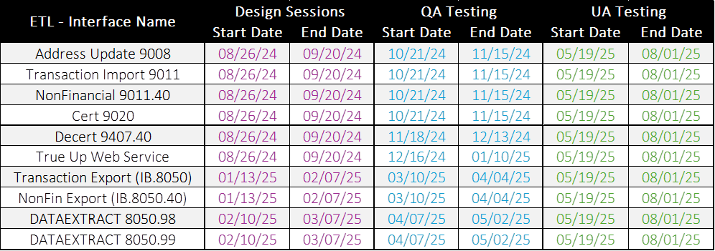
Design and Testing for ETLS

Slide 7
Upcoming Engagement
Session Name | Date(s)
Transaction Import (9011) | 9/12/2024: 1-3pm* 9/13/2024: 10am-12pm*
True Up Web Service (8405.40) | 9/16/2024: 1-3pm* 9/17/2024: 1-3pm* 9/19/2024: 10am-12pm* 9/19/2024: 1-3pm* 9/20/2024: 10am-12pm*
*Subject to change

Slide 8
Validation of Stakeholder Feedback
Pain Points/Concerns - Updated
Current collections system is inefficient and not programmed to handle certain aspects of the collections process, necessitating manual intervention (i.e., Tax memos process, payment error reports, etc.). Ongoing internal and design session discussions taking place.
Concerns around Client Invoicing as it relates to the current Compass Reports system. Ongoing internal discussions taking place.
Concerned about system access for Debt Manager (as some Tax Examiners can currently access debtors in CUBS directly), and ensuring that their agents should only be able to view and add notes. Will be addressed systematically through roles set for each user.
Concerns re: eliminating debt by bucket. Ongoing internal discussions taking place.
Concerns about AGI/CC calculating and being removed appropriately, both manually and when Tax passes an adjustment to the AGO for updates. Reviewing in design.
AGO processing overpayments without Tax memo/prompting. Ongoing internal discussions taking place.
Out of statute overpayments following Tax Statute and allowing adjustments to pass to DM accordingly. Ongoing internal discussions taking place.
Ease of taxpayer registration for the payment portal (out of scope)
TOPS notices – can the AGO send? Ongoing internal discussions taking place.

Slide 9
Resource Check-in /
Design Session Feedback

Slide 10
Comments/Questions

Slide 11
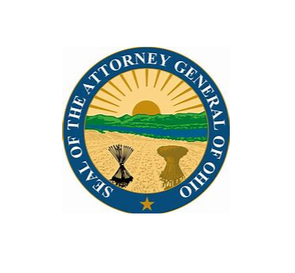
Thank You!

