Slide 1


Making the Move
to Debt Manager (DM)
Accounting Essentials for Your Team
Notes:
1

Slide 2

Welcome
from the AGO Collections Enforcement Accounting team
James Seeto
David Boals
Shawn Byrum
Bryce Hand
Dawn Taylor
Kyle Barnett
Director of Non-Legal Operations
Deputy Director of Data Analytics and Accounting
AC2, Accounting Subject Matter Expert
AC3, Accounting Subject Matter Expert
AP Supervisor, Direct pays and vendor payments
AP Supervisor, Agency-related payments
Notes:
Introduce the team

Slide 3


Today’s Agenda
  Changes in Reporting
  New Invoice Detail Report (IDR)
  Introducing the CARES FitPortal
  Q&A

Slide 4
Changes in Reporting
Current State
Future State
  Client View
  FitPortal
  Compass
  Invoice Detail Report (IDR)
Notes:
The Compass report found on Client Compass will be replaced by a collection of files called the IDR or Individual Detail Report found on the FitPortal

Slide 5



IDR Contents
Summary Reports
  PDF
  High level overview of total payment activity
Agency Payment Files
  CSV files
  Records of payments processed through AGO
Notes:
The IDR is made up of these three files

Slide 6

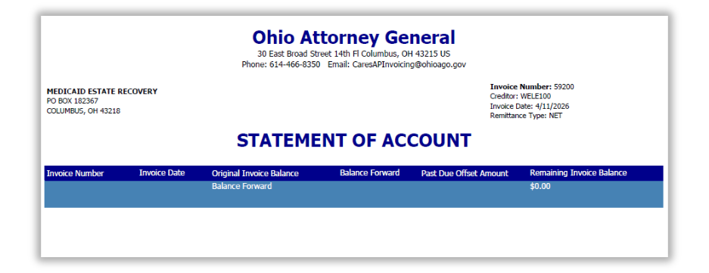
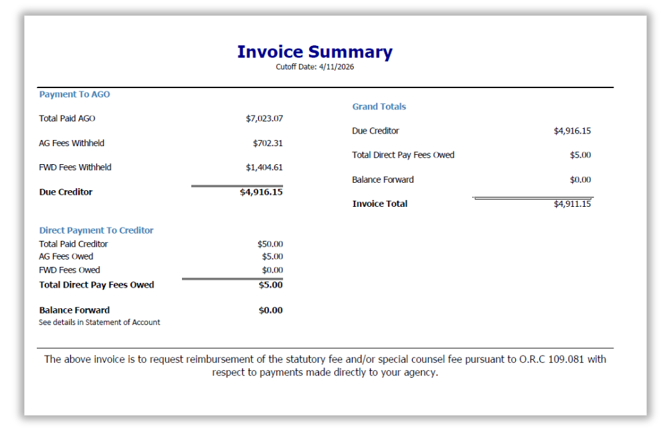
Summary File
Notes:
The new Summary file looks like this, it is a PDF

Slide 7
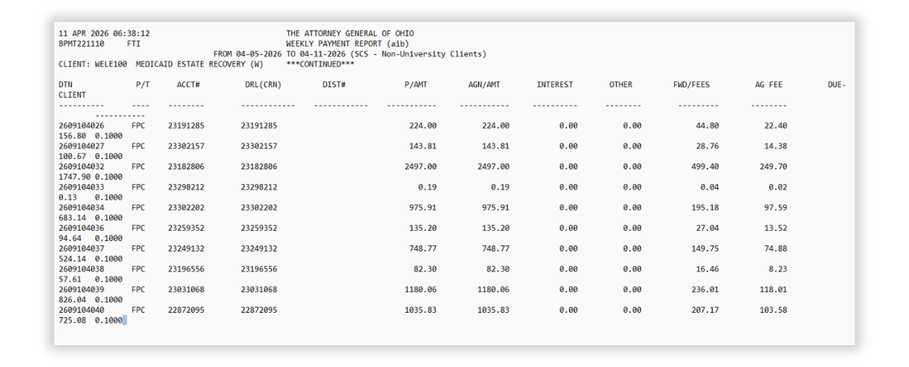
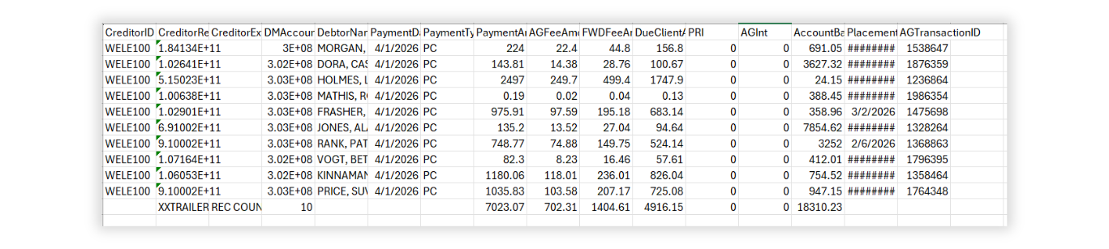
Agency Payment Files
From
CUBS
From
DM
Notes:
New agency payment file compared to the old one, this is a CSV also

Slide 8
File Location
FitPortal
CARES
SFTP
Compass
Summary Reports
  PDF
Agency Payment Files
  CSV files
The FitPortal will replace Compass
Notes:
Discuss where creditors can access different parts of the IDR note that Client Compass is going away

Slide 9
File Availability Schedule
Summary Reports
  PDF
Typically available Tuesdays
May shift to Wednesday on holiday weeks
Generally available Sundays or Mondays
May be delayed to Tuesday if additional processing is required
Agency Payment Files
  CSV files
-
Notes:
The files becomes available to you on this schedule

Slide 10

Introducing the
CARES FitPortal
Notes:
The FitPortal has been mentioned as the location for picking up files. Let's take a closer look

Slide 11

FitPortal
  Replaces Compass
  Provides access to reports (manager role)
  Houses debtor and account information
  Displays transactions
  Stores documents and letters pertaining to accounts
Portal training session coming soon!
Notes:
Things to know about the FitPortal

Slide 12
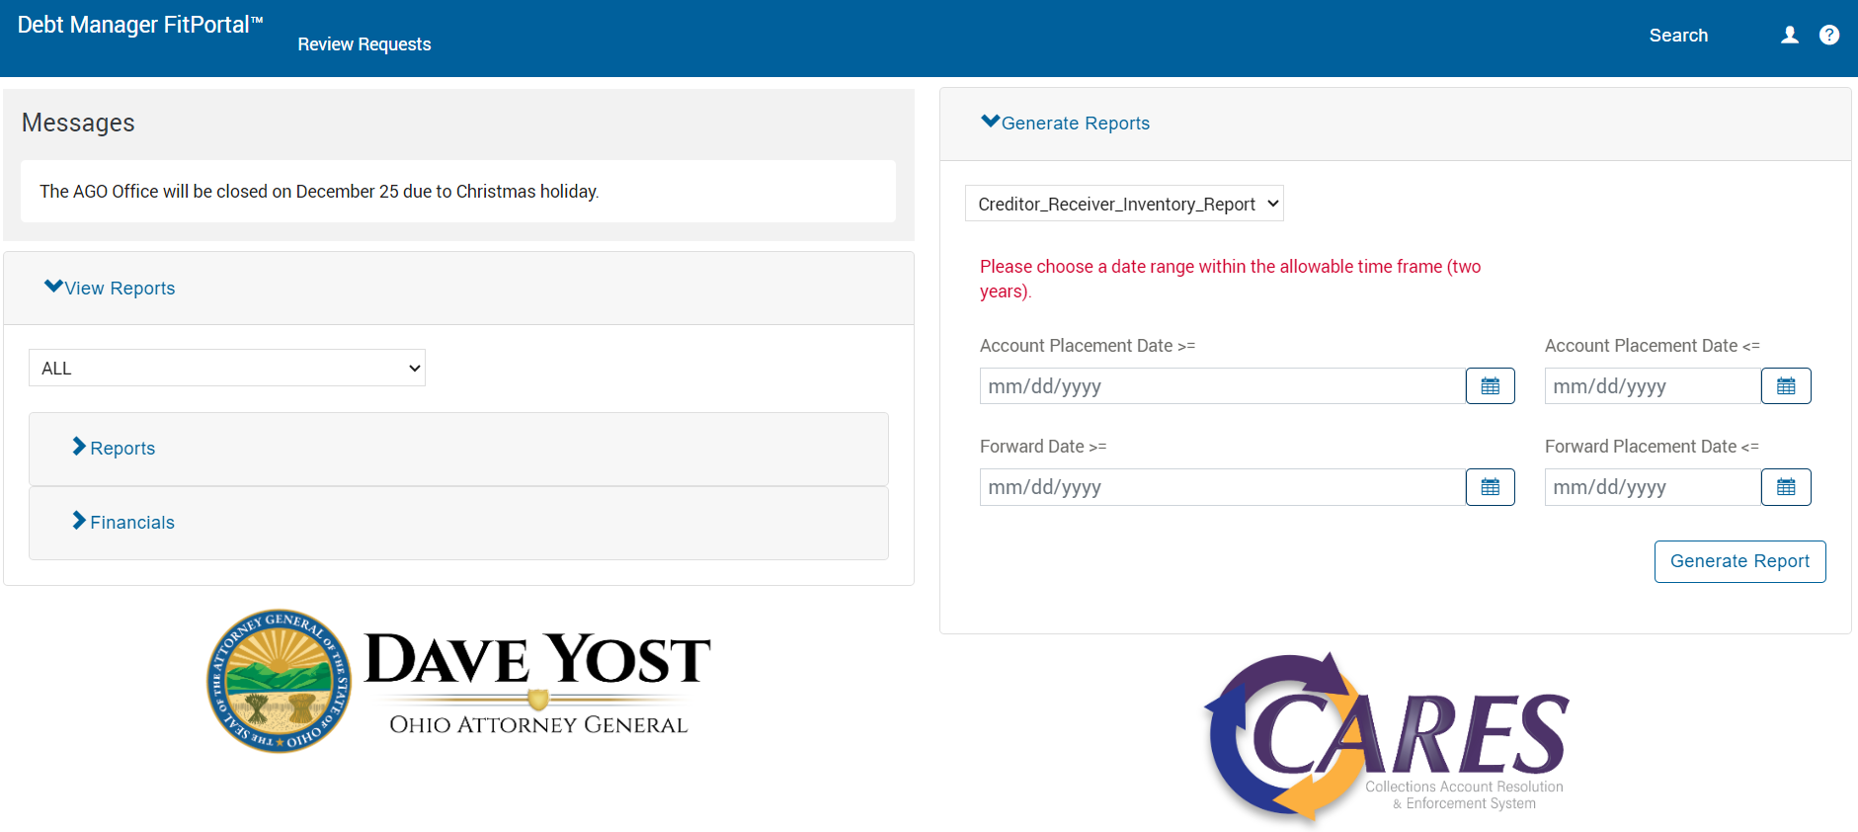
FitPortal Landing Page
IDR files appear here for those with Manager-level access
Notes:
When you log in to the FitPortal with manager access this is your landing page. The IDRs are found by clicking the dropdown arrow

Slide 13
Take Aways
  Invoice Detail Report (IDR) replaces Compass Report
  IDR includes:
    Summary Report
    Creditor Payments
    Agency Payments
Notes:
Review of the main points of the presentation

Slide 14
Take Aways
  IDR available on the new FitPortal
Report Locations
FitPortal
SFTP
  Agency Payment Files on SFTP
Summary
  Client Compass will no longer be used
Agency Payments
Notes:
Review

Slide 15
Take Aways
  Summary reports available Tuesdays
Report Availability
  Agency Reports available Sunday or Monday
Summary
Agency Payments
Notes:
Review

Slide 16

Questions
Contact Us
acctg-invoicing@ohioago.gov for direct pay invoicing questions
CaresAPInvoicing@ohioago.gov for other invoicing questions
Notes:
Question and answer time

