Slide 1
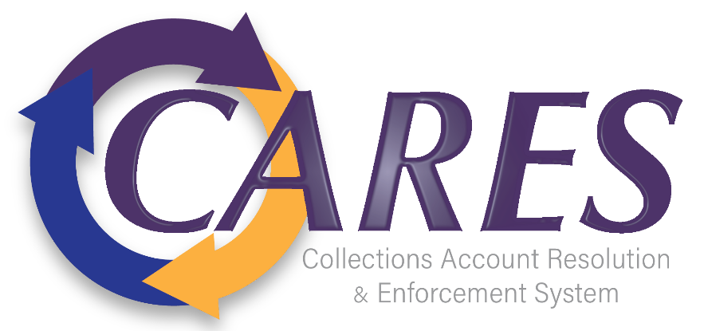
CARES Implementation Phase
Rollout #4 Personal Tax Kickoff
August 14, 2024

Slide 2
Agenda
AGO Collections modernization initiative
Discussion Topics | Presenters
Welcome & Introductions | Rebecca Hartman
CARES Program Overview Rollout #4 Scope, Objectives and Timelines | David Montgomery
Rollout #4 Plans | CARES Project Team
Workflows/Interfaces | Marissa Smith
Iteration Plan | Lisa Harrison
Data Migration Plans | Timothy Greene
Department of Taxation – Expected Involvement | Roy Robinson
Validate Stakeholder Feedback from Discovery Phase Standing Meeting Schedule Proposal | Rebecca Hartman
Open Discussion | All
Wrap-up | Rebecca Hartman

Slide 3

Rollout #4 - Program Overview, Scope & Objectives

Slide 4
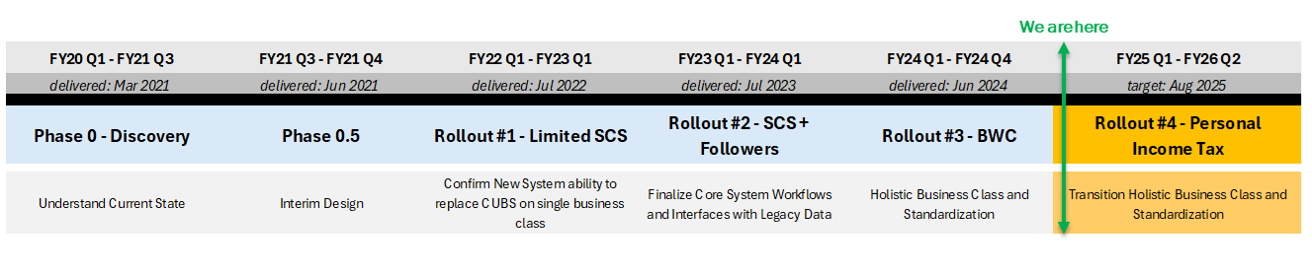
High Level Program Timeline
AGO Collections modernization initiative
A phased implementation strategy minimizes risk by incrementally building out core system functionality in a logical, sequential manner
Initial Rollout
Lay the Foundation – Core functionality that will benefit all aspects of the business, including common Workflows, Integrations, Letters, and Reports
Add the Business but Keep it Simple – Leverage the foundation + a small but meaningful layer of business class-specific functionality
  Day forward – Focus on new certifications before adding conversion of old data
  Internal Process Only – Focus on internal workflows before adding external partner workflows

Slide 5
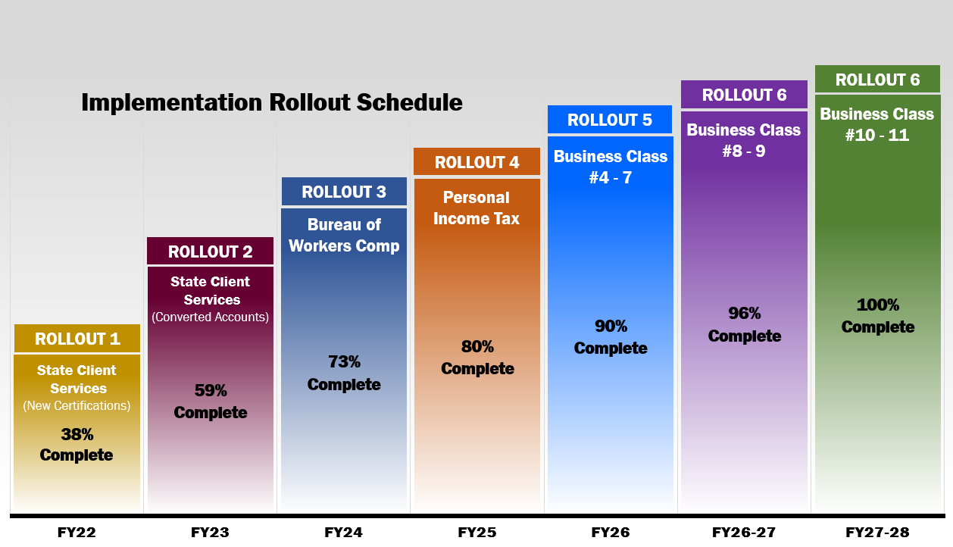

CARES Implementation Approach
AGO Collections modernization initiative
Our implementation plan is a buildup of the holistic system as we complete each rollout. The entirety of common workflows, interfaces, letters and reports are considered as we build the solution resulting in 80% of the system being complete at end of Rollout #4. Currently, as we initiate Personal Income Tax, we have completed roughly 73% of all common workflows, interfaces, letters and reports!

Slide 6
Rollout #4 Scope and Objectives
AGO Collections modernization initiative
Program Scope
Our CARES Program Strategy continues to focus on implementing the new Collections System incrementally. We will phase in all supported clients by business class while focusing on validating that Debt Manager can handle our new certifications, and legacy accounts.
Rollout #4 Objectives:
implement the Personal Income Tax business class into Debt Manager for all new and active accounts
migrate active legacy accounts from CUBS to Debt Manager
implement TOPS/OTOPS Offsets
implement our Electronic Bankruptcy Interface with the Defense Logistics Agency
implement Ohio Lottery Commission Real-time Interface
conform to FTI compliance policies and practices
Implementation Items:
7 Workflows, 48 to review
22 Interfaces
53 Letters
3 Reports
Notes:
Read Slide

Slide 7
AGO Collections modernization initiative
Rollout #4 – Timeline
Rollout #4 - Personal Income Tax
Week Ending | 26-Jul-24 | 23-Aug-24 | 20-Sep-24 | 18-Oct-24 | 15-Nov-24 | 13-Dec-24 | 10-Jan-25 | 7-Feb-25 | 7-Mar-25 | 4-Apr-25 | 2-May-25 | 16-May | 30-May | 13-Jun-25 | 11-Jul-25 | 1-Aug-25 | 22-Aug-25
Rollout #4 | Iteration | 1 | 2 | 3 | 4 | 5 | 6 | 7 | 8 | 9 | 10 | 11 |  |  |  |  |  | Live
PTAX Implementation Workstream
 | Project Initiation | Iteration 1 | Iteration 2 | Iteration 3 | Iteration 4 | Iteration 5 | Iteration 6 | Iteration 7 | Iteration 8
 |  |  | C&R SIT 1 | C&R SIT 2 | C&R SIT 3 | C&R SIT 4 | C&R SIT 5 | C&R SIT 6 | C&R SIT 7 | C&R SIT 8
 |  |  |  | AGO System Testing 1 | AGO System Testing 2 | AGO System Testing 3 | AGO System Testing 4 | AGO System Testing 5 | AGO System Testing 6 | AGO System Testing 7 | AGO System Testing 8 | AGO System Testing
 |  |  |  |  |  |  |  |  |  | AGO Regression and E2E System Testing |  |  | AGO Performance Testing
 |  |  |  |  |  |  |  |  |  | C&R Regression and E2E System Testing |  |  | C&R Performance Testing |  |  |  | Cutover Prep | Go Live
 |  |  |  |  |  |  |  |  |  |  |  |  | User Acceptance Testing |  |  |  | Dress Rehearsals

Slide 8
Rollout #4 Key Milestones
AGO Collections modernization initiative
Rollout #4 Milestone | Start Date | End Date | Status
Project Initiation | 7/1/24 | 7/26/24 | Completed
Iteration #1 | 7/29/24 | 8/23/24 | In Process
Iteration #2 | 8/26/24 | 9/20/24
Iteration #3 | 9/23/24 | 10/18/23
Iteration #4 | 10/21/24 | 11/15/24
Iteration #5 | 11/18/24 | 12/13/24
Iteration #6 | 12/16/24 | 1/10/25
Iteration #7 | 1/13/25 | 2/7/25
Iteration #8 | 2/10/25 | 3/7/25
End-to-End System Testing | 3/10/25 | 5/16/25
User Acceptance Testing | 5/19/25 | 8/1/25
Go Live | 8/4/25 | 8/25/25

Slide 9
Rollout #4 Plans

Slide 10
AGO Collections modernization initiative
Rollout #4 PTX Scope – Workflows
C&R Software to configure 7 workflows and assess the reuse of 48 workflows from prior rollouts for change as identified below. Assumption is they will not change.
New Workflows
Innocent Spouse
Tax Collections
Tax Memos
Tax Penalty Abatements
Tax FTP Process
TOPS and OTOPS Offset
Creditor Setup - PTAX

Slide 11
AGO Collections modernization initiative
Rollout #4 PTX Scope – Interfaces
C&R Software to configure 22 interfaces as identified below.
Interfaces
Transaction Export (IB.8050)
NonFin Export (IB. 8050.40)
Data Extract (8050.98)
Data Extract (8050.99)
Address Update (9008)
Transaction Import(9011)
Non-Financial (9011.40)
Cert (9020)
Decert (9407.40)
True Up Web Service (8405.40)
TOPS/OTOPS Send File
Interfaces
TOPS/OTOPS Collections File
TOPS/OTOPS Error File
TOPS/OTOPS Debt Balance Inbound
SOVOS – 1099
OIC Application Intake
OIC Compliance Check Request
OIC Compliance Check Response
Unclaimed Funds – Match Request Outbound
Unclaimed Funds – Match Request Inbound
Key Bank – XBKY, XOIC
TCI – Trustee Checks

Slide 12
Rollout #4 – Iteration Plan
AGO Collections modernization initiative
Scope is sequenced and prioritized in the Iteration Plan based on risk, business value, and their dependency on other functionality and priorities.
Iteration 1
Iteration 2
Iteration 3
Iteration 4
Iteration 5
Workflows
Skip Trace
Personal / SD Tax Collections
Creditor Setup
Integration
Certifications 9020
SOVOS-1099
Skip Trace – Request File
Skip Trace – Response File
Other
Letters Related to Tax Collections
Workflows
Rework Workflows (Accounting, Legal and Forwarding) Integration
Address Update 9008
NonFinancial 9011.40
Decertification 9407.40
Transaction Import 9011
True-Up Web Service 8405.40
Other
Letters/Reports
Roles/Privileges
Workflows
TOPS and OTOPS
Liens Letter Batching
Other
Letters/Reports
Workflows
Offer in Compromise (OIC)
Integration
TOPS / OTOPS Send File
TOPS / OTOPS Collections File
TOPS / OTOPS Error File
TOPS / OTOPS Debt Balance Inbound
Other
Letters/Reports
Workflows
Tax Memo
Integration
OIC – Compliance Check Request (OB)
OIC – Compliance Check Response (IB)
OIC Application Intake
Other
Letters/Reports
The final timeline for Rollout #4 is “under discussion” and subject to change based upon finalizing plans in Iteration #1.

Slide 13
Rollout #4 – Iteration Plan
AGO Collections modernization initiative
Continued.
Iteration 6
Iteration 7
Iteration 8
Workflows
Tax FTP Process
Tax Penalty Abatements
Integration
OIC Application Intake
Other
Letters / Reports
Workflows
Tax Penalty Abatements
Integration
Unclaimed Funds – Match Request (OB)
Unclaimed Funds – Match Request (IB)
Transaction Export (IB.8050)
NonFinancial Export (IB.8050.40)
KeyBank – XBKY, XOIC
TCI – Trustee Checks
Other
Letters/Reports
Workflows
Custom Card 1
Custom Card 2
Custom Card 3
Integration
TCI – Trustee Checks
Data Extract 8050.98
Data Extract 8050.99
Other
Letters/Reports
The final timeline for Rollout #4 is “under discussion” and subject to change based upon finalizing plans in Iteration #1.

Slide 14
AGO Collections modernization initiative
Rollout #4 PTX Scope – Data Migration
AGO Data Migration Team to migrate legacy Tax data and accounts to Debt Manager.
Data Migration
Includes all PTAX new certifications and accounts
AGO Data Migration Team to extract active accounts from CUBS data and upload to Debt Manager
AGO Data Migration Team and Collections to parse, normalize, cleanse and transform legacy data
AGO Data Migration Team and C&R Software to reconcile conversion results

Slide 15
AGO Collections modernization initiative
Rollout #4 – Data Migration Approach
Our data migration approach was created with the intent to ensure legacy CUBS data is extracted in a quality manner for uploading into Debt Manager. Our objective is for this to be seamless with limited impact on our clients. The new Debt Manager System enforces quality editing, formatting and standards upfront (unlike CUBS), so our approach is to apply these data rules when new certifications are submitted for loading into the new Debt Manager System for minimizing impact on our clients.
The following are for your awareness in our approach:
Conversion of data from CUBS to Debt Manager will take place in the days leading up our planned launch. During that time, there may be a freeze of sending CUBS files in the old layout while the CUBS data is being converted. We will communicate any anticipated freeze times in advance; however, you should be prepared to send any new certifications using the new CCI file layout.
We are currently identifying and applying data cleansing rules against existing CUBS data to ensure the migrated data meets the standards of the new system. We're also working with a cross-functional team to compare data between CUBS and Debt Manager to ensure all data is valid and mapped appropriately prior to the launch of Debt Manager.

Slide 16
AGO Collections modernization initiative
Taxation’s Expected Involvement
Taxation will be included in design phase. Though we are not expecting code changes based upon initial designs during Discovery and prior Rollouts, we will work with Taxation for any changes to layout. We will expect Taxation to provide/process test files and supporting any testing needed.
Area | Involvement | Estimated Timeframes | Comments
Interface Inbound (From Tax) Certification File, Decertification file Address Update, NonFinancial file Transaction Import True Up Web Service | Design, Testing | Late Aug/Sept Testing May 2025 | Possible changes based upon design
Interface Outbound (to Tax) Transaction Export, Data Extract NonFinancial File Export OIC Compliance Check Request (both) | Design, Testing | Nov/Dec Testing May 2025 | Possible changes based on design
Client Inventory & Recon Outbound | Testing | Ready Now | Designs completed in R3 with all AGO clients including Taxation
Data Migration | Validation & Testing | Feb - Apr

Slide 17
Validation of Stakeholder Feedback

Slide 18
Validation of Stakeholder Feedback
Pain Points
Current collections system is inefficient and not programmed to handle certain aspects of the collections process, necessitating manual intervention (i.e., Tax memos process)
Concerns around Client Invoicing as it relates to the current Compass Reports system
Concerned about system access for Debt Manager (as some Tax Examiners can currently access debtors in CUBS directly)

Slide 19
Validation of Stakeholder Feedback
Critical Success Factors for PTAX
Training is paramount
Accurate reporting is critical
Less manual review/intervention
Seamless integration between DM and OH Tax

Slide 20
Validation of Stakeholder Feedback
PTAX IT Concerns
Ensuring the webservice integration for Debt Manager is implemented successfully
Maintaining open lines of communication between AGO ITS & Taxation IT

Slide 21
Proposed Standing Meeting Cadence
Frequency: Bi-weekly
Day/time: Wednesdays at 11 am
Duration: 1 hour
First three meeting dates:
  August 14, 2024
  August 28, 2024
  September 11, 2024

Slide 22
Bi-Weekly Meeting – Proposed Agenda
Current Status
Accomplishments
Obstacles/Issues/Risks
Schedule Review
  Next 30 Days
Action Items
Resources Check-in
Comments/Questions

Slide 23
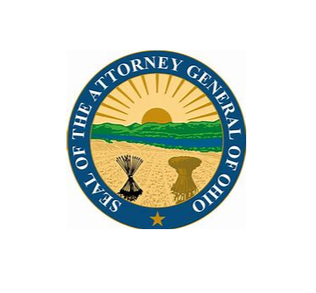
Thank You!

